Slide 1
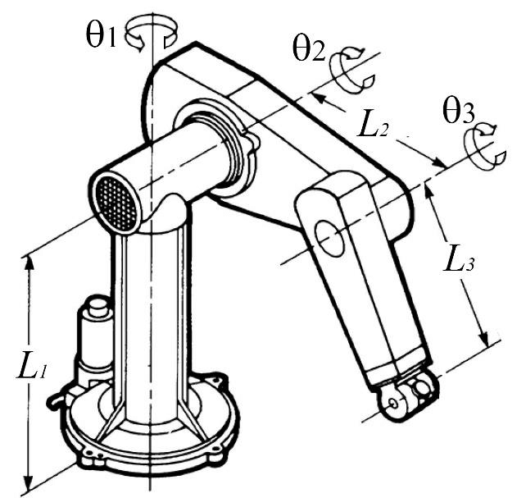
In the PUMA manipulator shown in the figure below, assign frames according to the DH method. Then derive the DH table and simulate the robot in MATLAB.

Slide 2
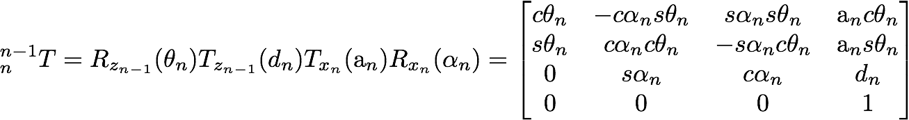
Standard (distal) DH convention
Z_{n} axis of n+1th joint
X_{n} is normal to both Z_{n-1} and Z_{n} from n-1 to n
a_{n}: distance along x_{n}, z_{n-1}->z_{n}
α_{n}: rotation about x_{n}, z_{n-1}->z_{n}
d_{n}: distance along z_{n-1}, x_{n-1} -> x_{n}
θ_{n}: rotation about z_{n-1}, x_{n-1} -> x_{n}
n | a_{n} | a_{n} | d_{n} | θ_{n}
1

Slide 3
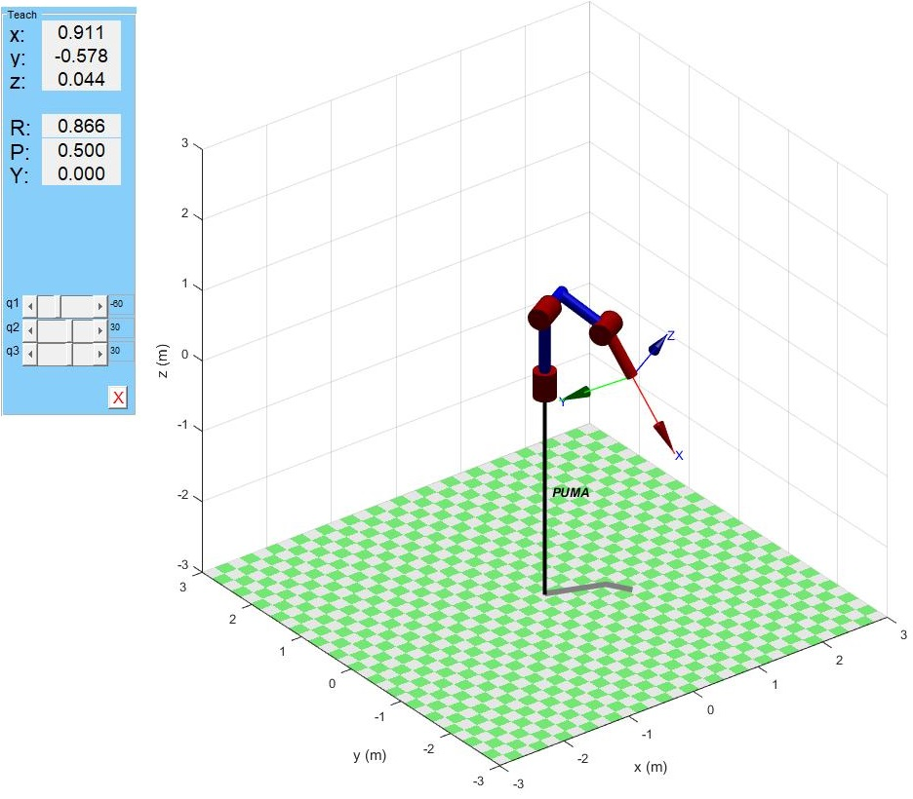
Frames by the standard (distal) DH convention
d₂
z₁
z₂
x₁
x₂
z₀
z₃
x₃
x₀
Standard DH table
n | a_{n} | a_{n} | d_{n} | θ_{n}
1 | 0 | -90º | L₁ | θ₁
2 | L₂ | 0 | d₂ | θ₂
3 | L₃ | 0 | 0 | θ₃
Example of simulation in MATLAB
using Peter Corke’s robotic toolbox

Slide 4
Example code
clear
clc
L1 = 1 ;
L2 = 0.7 ;
L3 = 0.7 ;
d2 = 0.5 ;
J1 = Link('d', L1,'a',0,'alpha',-pi/2); %
J2 = Link('d', d2,'a',L2,'alpha',0); %
J3 = Link('d', 0,'a',L3,'alpha',0); %
% Define the serially connected robot:
PUMA = SerialLink([J1 J2 J3], 'name', 'PUMA')
%You can now "teach" the robot by changing q1 q2 q3 and see the x,y,z and
%Roll-Pitch-Yaw
PUMA.plot([-pi/3,pi/6,pi/6])
PUMA.teach
xlabel('x (m)')
ylabel('y (m)')
zlabel('z (m)')

